Slide 1

Data Communication and Network Library Network
Prabhat Suman

Slide 2
Library Network
Objective:
To establish network connectivity in a long library hall considering only 2 wireless routers which is interconnected in series.
Implement and analyse this network plan of a long library hall.

Slide 3
Theory:
This experiment is performed to find out that how can we provide network connectivity to each person sitting in a long library hall.
We have tried to find out that how to configure wireless router and which devices will be needed for accomplishing our goal. We will be needing switches along with wireless routers.
For designing the Library Network Cisco packet tracer is used, it is a networking simulator used for learning and teaching programming by offering a unique realistic combination.

Slide 4
Benefits of packet tracer:
It offers a real time simulation and visualization.
Permits user to design, to build, configure and troubleshoot complex networks.
Allows students to explore concepts and conduct experiments.
The Dynamic Host Configuration Protocol (DHCP) is used for assigning IP here.

Slide 5
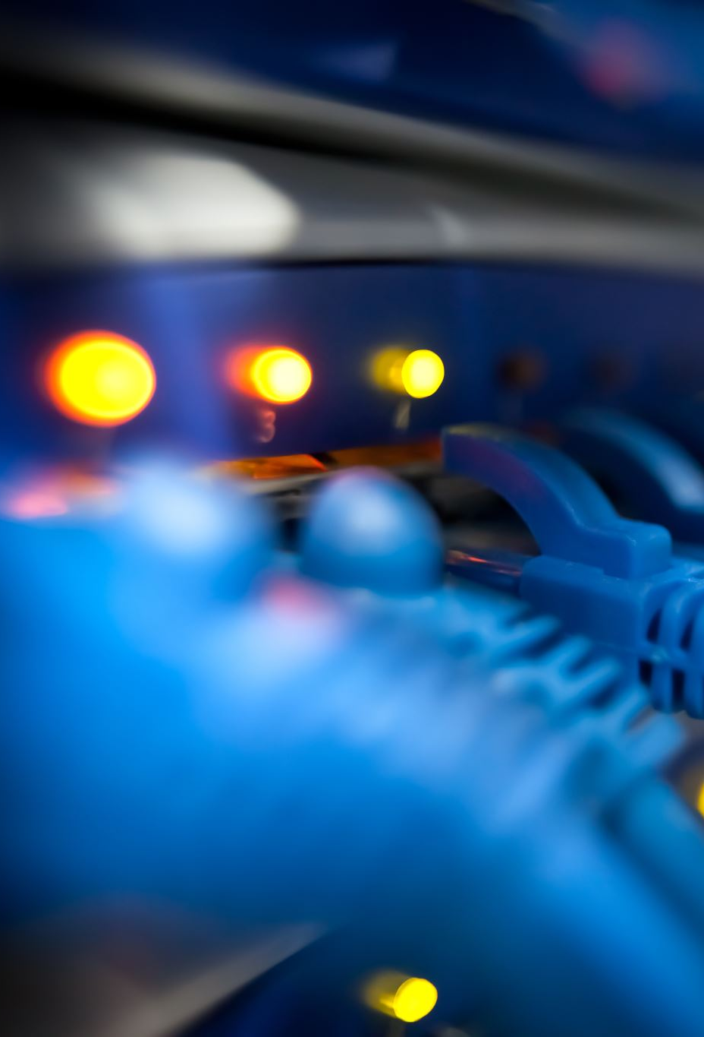
Devices:
Routers:
A router is a device like a switch that routes data packets based on their IP addresses. Router is mainly a Network Layer device. Routers normally connect LANs and WANs together and have a dynamically updating routing table based on which they make decisions on routing the data packets.
Routers divide broadcast domains of hosts connected through it.

Slide 6
Devices:
Switch:
A switch is a multiport bridge with a buffer and a design that can boost its efficiency (a large number of ports imply less traffic) and performance.
A switch is a data link layer device. The switch can perform error checking before forwarding data, that makes it very efficient as it does not forward packets that have errors and forward good packets selectively to correct port only. In other words, switch divides collision domain of hosts, but broadcast domain remains same.

Slide 7
Dynamic Host Configuration Protocol (DHCP):
It is a network management protocol used on Internet Protocol networks whereby a DHCP server dynamically assigns an IP address and other network configuration parameters to each device on a network so they can communicate with other IP networks. A DHCP server enables computers to request IP addresses and networking parameters automatically from the Internet service provider (ISP), reducing the need for a network administrator or a user to manually assign IP addresses to all network devices.

Slide 8
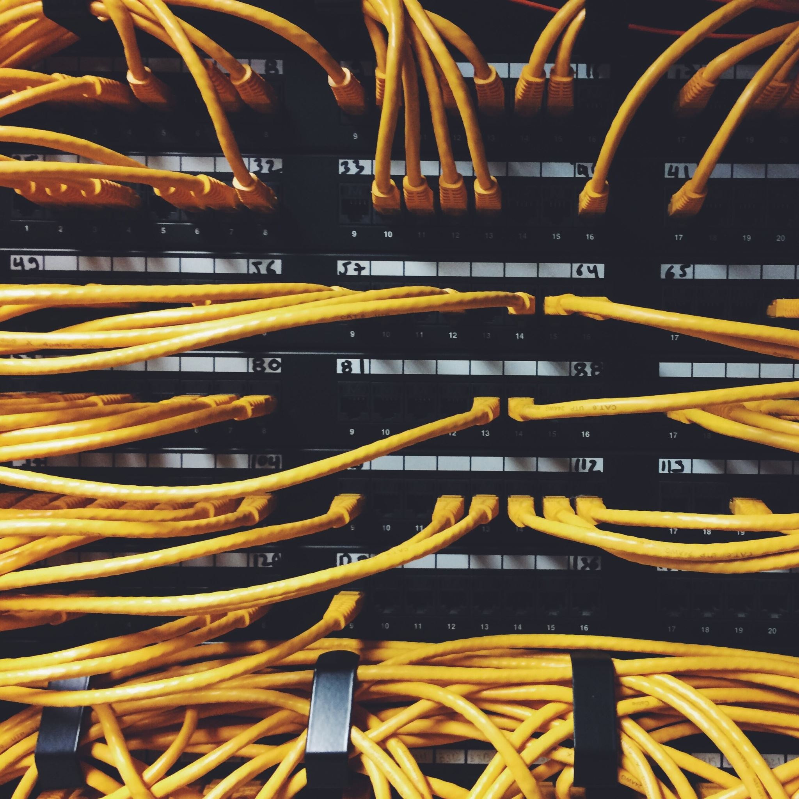
Data & Observations

Slide 9
Observations:
Topology view allows us to keep track of the physical locations of your network devices. This helps us easily locate devices if maintenance is required.
If we put mobile devices in closet, it loose network connection.
Wireless router has only 4 ethernet port, so if we need more devices to connect through wires then we have to add switch.
We can visualize the range of wi-fi by looking into Physical Mode.
Wireless Home router contain 3 bandwidths, so we must assign security to all the 3 bandwidths to secure our network.

Slide 10
Observations:
Our Proposed model has following characteristics:
Two wireless routers connected in series placed such that it covers whole library hall.
LAN is used to connect computing resources such as computers, printers, servers, IP phones, typically inside one hall.
Star topology is used in the network.
In order to make connection secure we have added a password to each Wireless router.
Switch is used for each computing machine like laptop, printers etc. Smartphones are connected through wi-fi.

Slide 11
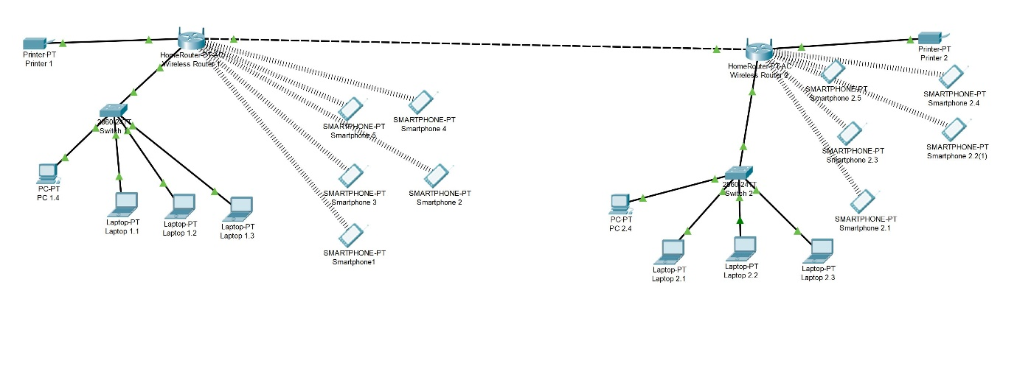
Network Connection

Slide 12
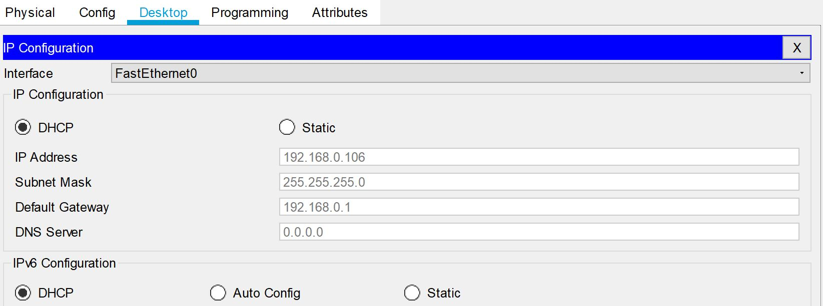
DHCP Configuration

Slide 13
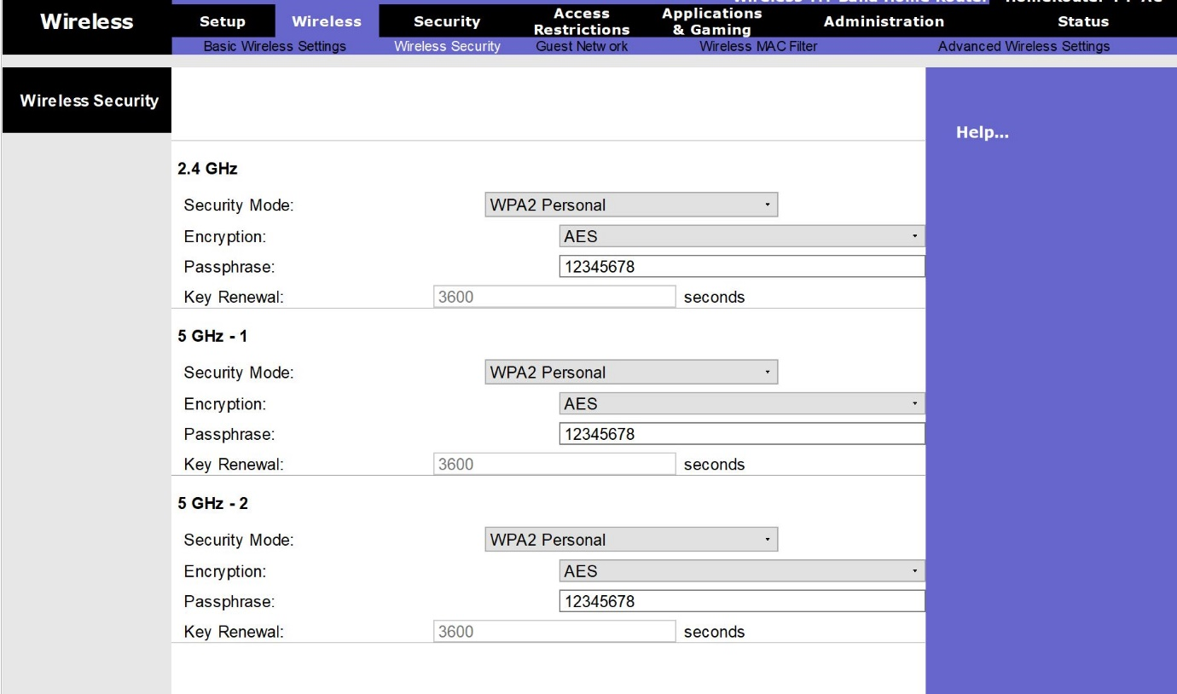
Wireless Authentication Setup

Slide 14
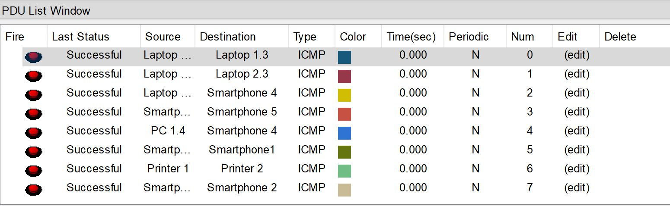
Packet Transfer

Slide 15
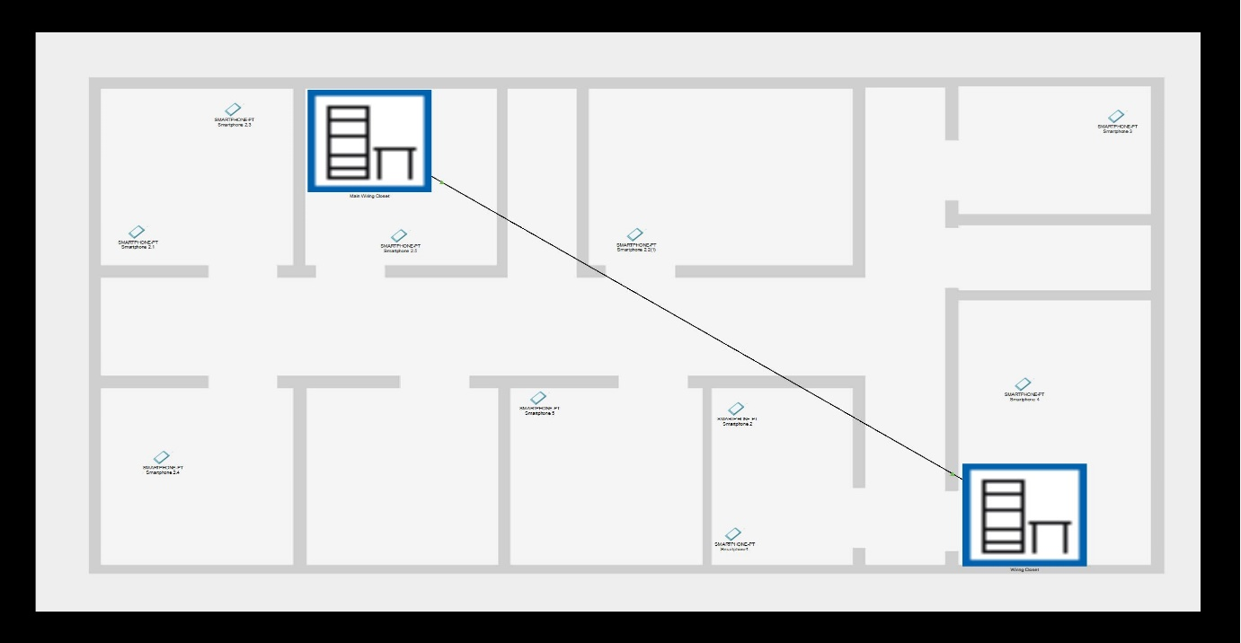
Physical Mode View

Slide 16
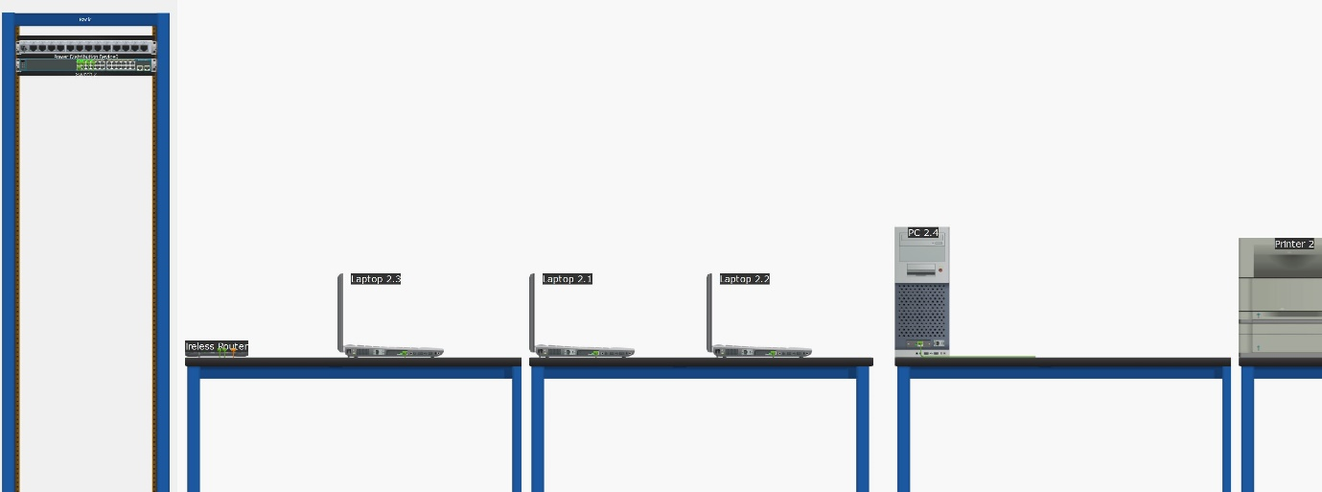
Closet View

Slide 17
Discussion & Conclusion

Slide 18
Discussion
The establishment of proposed Library network design has been done in a simulated environment. The routers and the computer system configured accordingly. Packets were sent from one computer to the other and the transmission of such data to their destination was successful in an efficient manner. For security facilities to the network various methods are implemented like Password protection is also applied on the wireless routers for restricted usage and which can be used only for library.

Slide 19
Discussion
Testing was done for the simulated network and it performed like a real computer network. This shows that this library network will work perfectly when implemented in real-time situations.

Slide 20

Conclusion
This proposed idea helps in designing the network outlook for the library network that provides the different functionalities within a single network such as security of the network, wireless area network, mobility, operational efficiencies and a costs effective network for better use by students, staffs etc.

Slide 21
Conclusion
Wireless LAN is changing entire network environments with new style, Wireless LAN technologies still have a long way to go in several aspects. Both fundamental and practical problems still persist in this area. Therefore, much precaution must be taken to ensure the success of emerging wireless applications when implementing high securable wireless networks. While the wireless LAN provides portability and flexibility, increased productivity, and lower installation with much easy and convenience, security is coming to play major role that we must pay much attention on security risks. Continuous LAN security monitoring is crucial. We must also much attention on Bandwidth hijacking and Data encryption by automated check and report

Slide 22



